Slide 1
Unit 10
I’d like some noodles.
Section A 2a-2d
七年级(下)

Slide 2

Objectives
To learn to use some and any
To learn food names: noodles, beef, mutton, chicken, tomatoes…

Slide 3
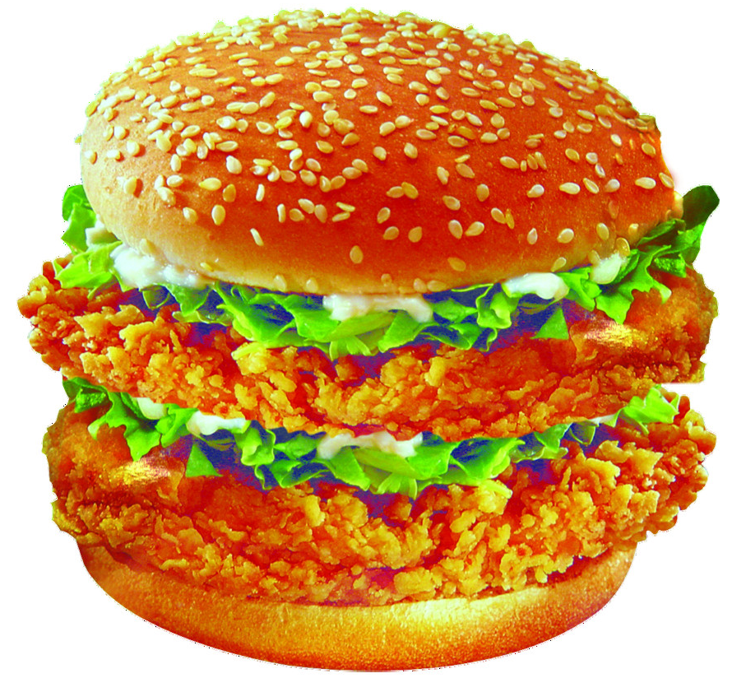
比眼力
What food is it?
It’s a hamburger.

Slide 4
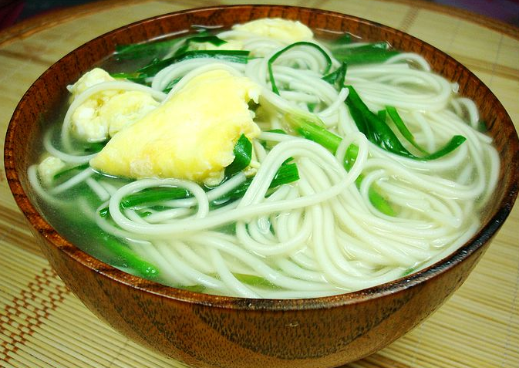
What food is it?
It’s a bowl of egg noodles.

Slide 5
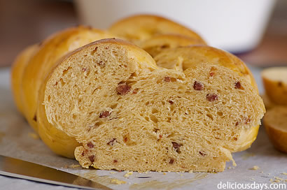
What food is it?
It’s bread.

Slide 6
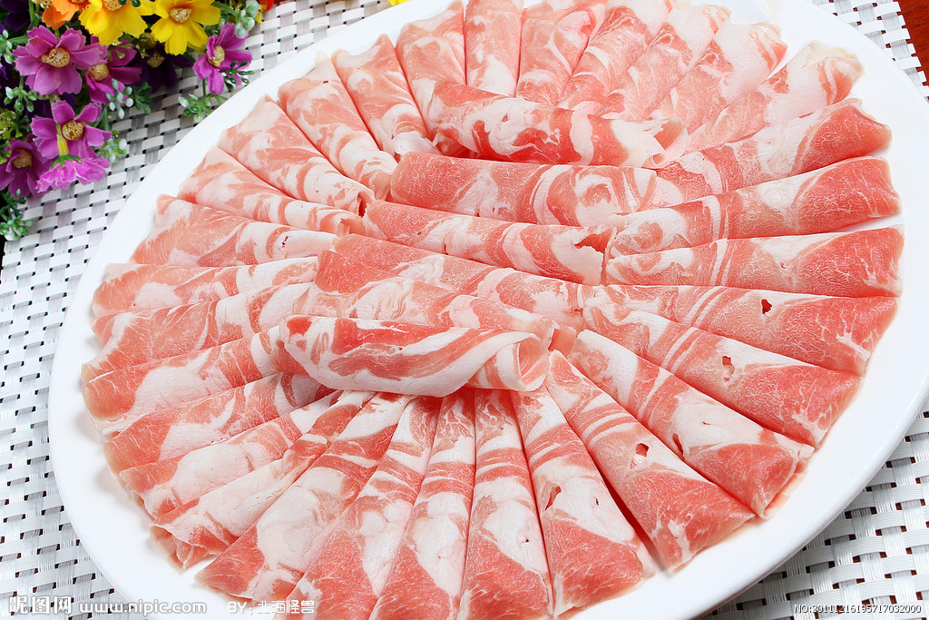
What food is it?
It’s mutton.

Slide 7
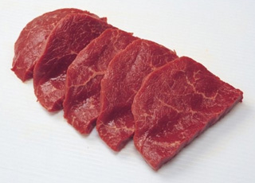
What food is it?
It’s beef.

Slide 8
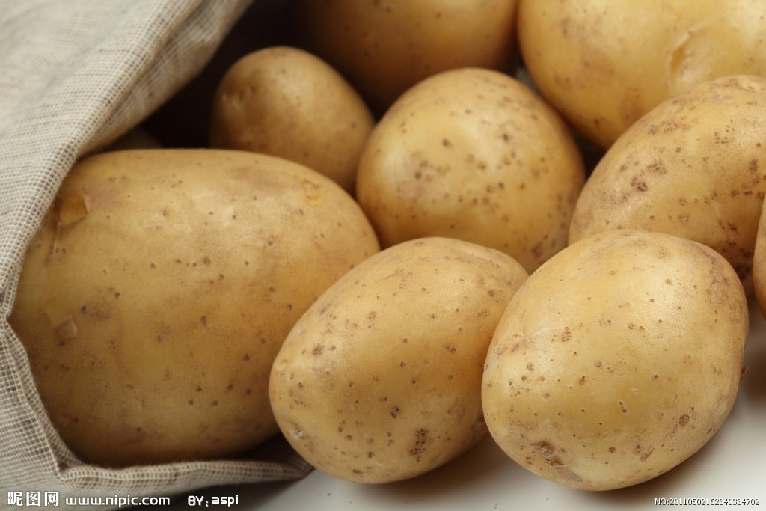
What vegetables are they?
They’re potatoes.

Slide 9
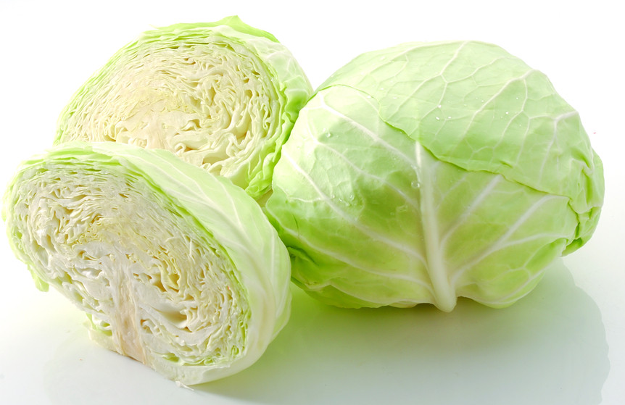
What vegetables are they?
They’re cabbages.

Slide 10
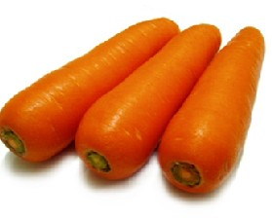
What vegetables are they?
They’re carrots.

Slide 11
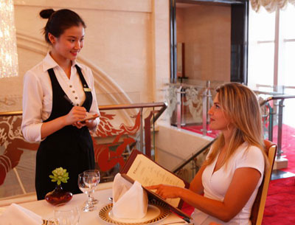
Presentation
What would you like?
I’d like some egg noodles?

Slide 12


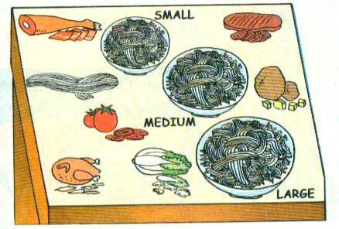
Listening
2a
Listen and check (√) the names of the foods in the box.
1. __ noodles
2. __ beef
3. __ mutton
4. __ chicken
5. __ tomatoes
6. __ cabbage
7. __ potatoes
8. __ vegetables
√
√
√
√
√
√

Slide 13
Listen again. Complete the sentences.
2b
Boy: 1. I’d like a ______ bowl of noodles.
2. I’d like _______, ______ and
________ noodles.
large
chicken potato
cabbage
Girls: 1. I’d like a _________ bowl.
2. I’d like _____ and ________
noodles, please.
medium
beef tomato

Slide 14
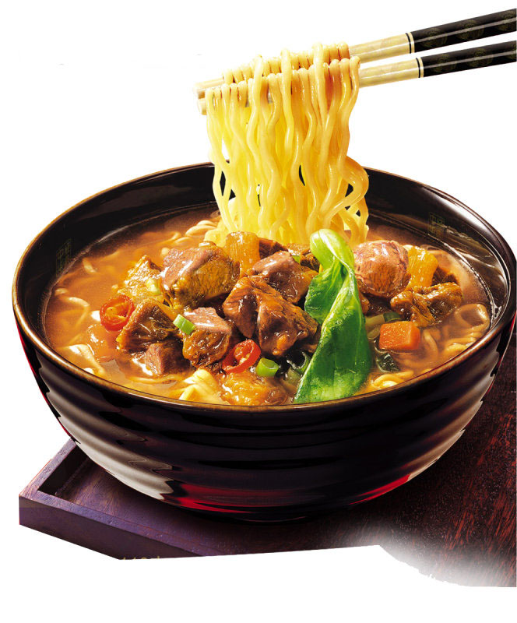
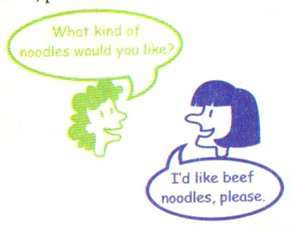
Pairwork
Ask and answer questions with your partner. Use the information in 2a.
2c

Slide 15

What size would you like?
I’d like a large bowl of noodles.
And what kind of noodles would you like?
I’d like chicken, potato and cabbage noodles.

Slide 16
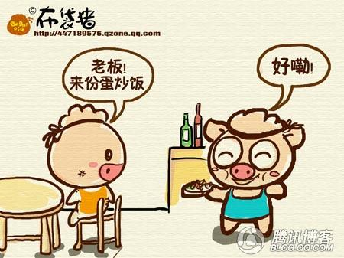
I’d like a medium bowl.
What size would you like?
I’d like beef and potato noodles.
What kind of noodles would you like?

Slide 17
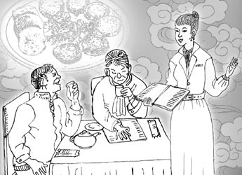
I’d like a small bowl.
What size would you like?
I’d like mutton and cabbage noodles.
What kind of noodles would you like?

Slide 18
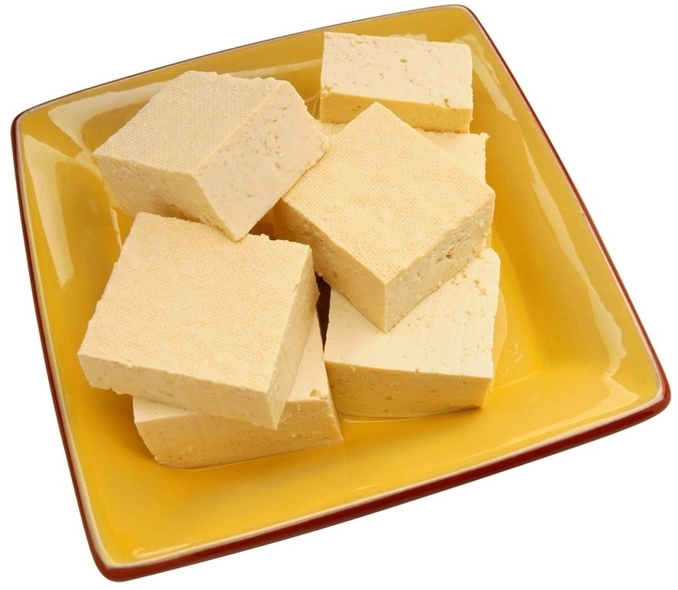
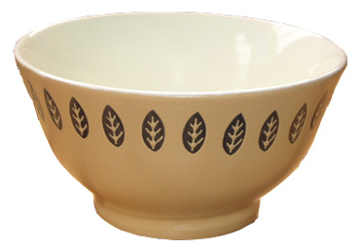
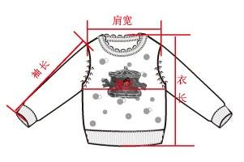
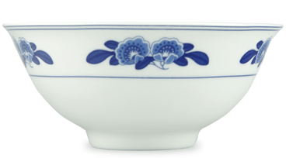
Main Words
bowl
tofu
order
size
small
large

Slide 19
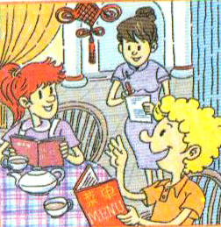
Role-play
2d Role-play the conversation.
Waiter: Good afternoon. May I
take your order?
Sally: Yes. Are there any vegetables in the
beef soup?
Waiter: Yes. There are some tomatoes.
Sally: OK. We’d like one bowl of beef soup.
Waiter: Sure. What size would you like?

Slide 20
Sally: Large, please.
Tom: We’d also like gongbao chicken and some mapo tofu with rice.
Waiter: OK. One large bowl of beef soup, one gongbao chicken, and one mapo tofu with rice.
Tom: Yes, that’s right.

Slide 21
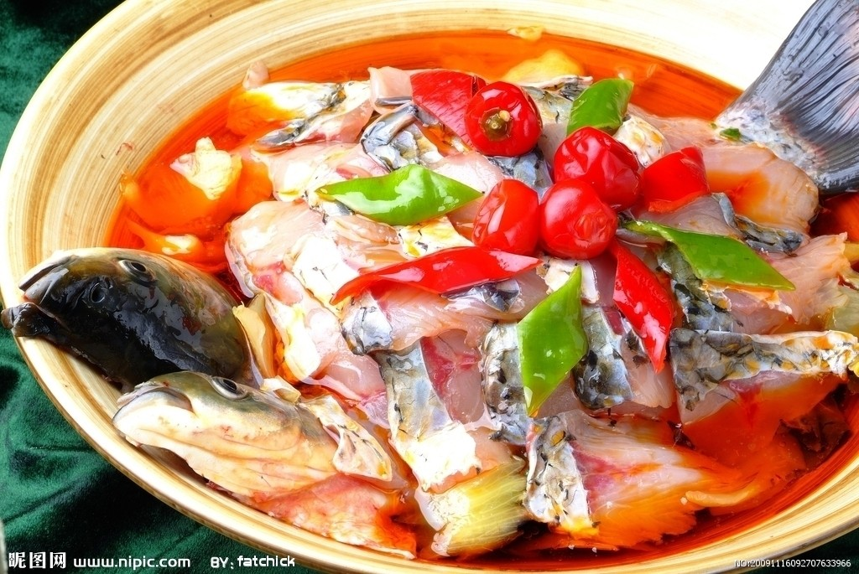
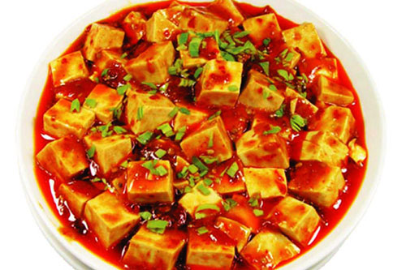
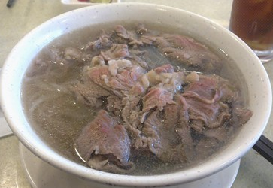
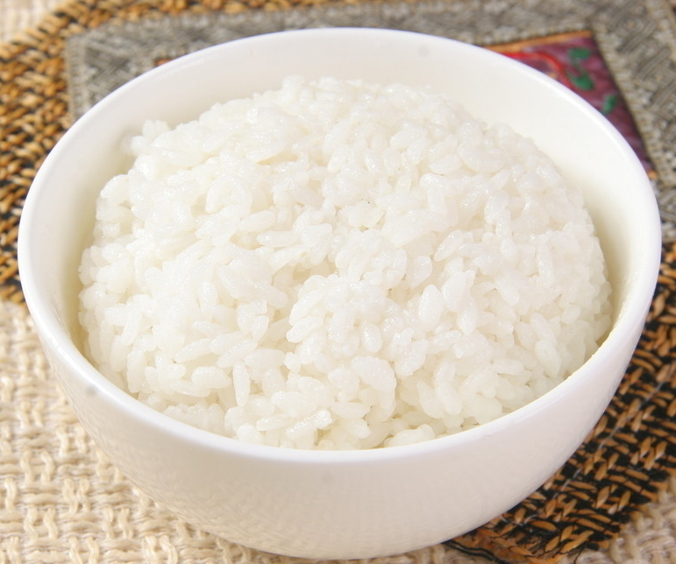
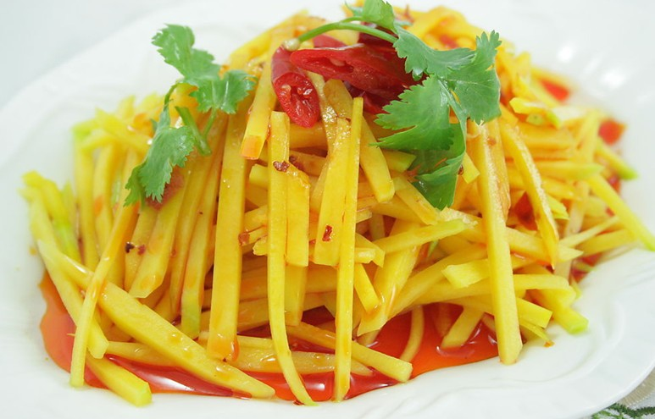
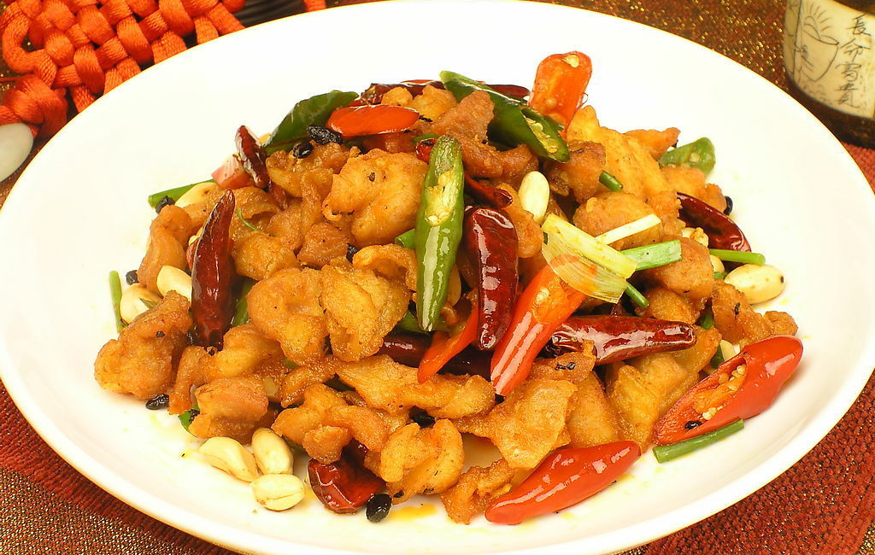
Read the conversation in 2d and check their food.
Reading
√
√
√
√

Slide 22
Language Points
1. May I take your order?
你可以点菜了吗？
也可以说“Can I take (have) your order?”, “Are you ready to order?”这些都是服务 员请客人点菜的礼貌用语。
例如：
─ May I take your order?
— Yes. I’d like some mapo tofu with rice.

Slide 23
2. a bowl of 一碗……
two bowls of 两碗……
我想要一碗牛肉洋白菜面。
I’d like a bowl of beef cabbage noodles.
我们想要两碗羊肉胡萝卜汤。
We’d like two bowls of mutton carrots soup.

Slide 24
3. What kind of noodles would you like?
kind 在此句中作“种类”讲，a kind of
“一种”，all kinds of “各种各样的”。
比一比：kind of “有几分”
A cat is a kind of animal.
The cat is kind of smart.

Slide 25
4. What size would you like? 你要多大的？
size 用作名词，其意有：(……的)大小
或(鞋子、衣服等的)尺寸；号码。询问别
人想要多大的东西时，常用what size …,
而不是how many size或how much size…
e.g. – Well, a bowl of noodles with beef and
tomatoes. OK, then what ______ would you
like, sir?
-- A small bowl, please.
A. price B. time C. size D. height
C

Slide 26

拓展
some和any的用法
1
some和any 既可以修饰可数名词又可以修
饰不可数名词, some常用在肯定句中, 而
any则常用在否定和疑问句中。所以, some
和 any 的区别在于: some和any 的用法主要
是考虑用在肯定句、疑问句还是否定句中, 与名词的可数与否无关。

Slide 27
2
some的用法: some意为“一些”，可作形
容词和代词。它常修饰可数名词复数。
如：some books 一些书，
some boys 一些男孩，
也可修饰不可数名词：
some water 一些水，some tea 一些茶叶，
some 常用在肯定句中。

Slide 28
3
any的用法: any意为“任何一些”，它也
可修饰可数名词复数或不可数名词，常
用于疑问句和否定句。如：
I can’t see any tea. 我没看见茶叶。
Do you have any friends at school?
你在学校有些朋友吗?

Slide 29
4
但在表示建议，反问，请求的疑问句中，或
期望得到肯定回答时，多用some而不用any。
如：Would you like some coffee?
你要不要来点咖啡?
How about some fruit juice?
来点果汁如何?

Slide 30
5
当any表示“任何”的意义，起强调作用时，
它可以用在肯定句中；
如：Any student can answer this question.
任何学生都可以回答这个问题。

Slide 31
Exercise
补全下列对话。
order
Waiter: May I take your ______?
Jack: Yes. Are there any _________ in the mutton soup?
Waiter: Yes. There ____ some carrots.
Jack: OK. Can I have one ______ ____ mutton soup, please？
vegetables
are
bowl
of

Slide 32
Waiter: Sure. What ______ _______ your like?
Jack: Large, please. I’d also like some gongbao chicken _______ rice.
Waiter: OK. One bowl of mutton soup and some gongbao chicken
with rice.
size
would
with

Slide 33
选择适当的单词完成句子。
would, special, noodles, large, size
1. What ______ bowl of soup does the
boy want?
2. Would you like some beef ________?
3. Oh, this T-shirt is too _____. It
doesn’t fit (适合) me.
4. This is the ________ in this restaurant.
It’s very delicious (美味的).
5. His father ________ like some mutton.
size
noodles
large
special
would

Slide 34
填入恰当的问句完成下列对话。
1. — ____________________________?
— A medium bowl, please.
2. — ____________________________?
— Yes, please. I like chicken.
3. — _____________________________?
— She’d like to eat a hamburger.
4. — ________________________________?
— I’d like tomato and egg noodles.
What size bowl would you like
Would you like some chicken
What would she like to eat
What kind of noodles would you like

Slide 35
Translate and write them down.
我想要些面条。
2. - 你想要哪种面条？
- 请给我牛肉西红柿面条。
3. 牛肉面里头有蔬菜吗？
4. 西红柿鸡蛋汤里面有肉吗？
1. I’d like some noodles.
2. --- What kind of noodles would you like?
---Beef and tomato noodles, please.
3. Are there any vegetables in the
beef noodles?
4. Is there any meat in the tomato
and egg soup?

Slide 36
Homework
记忆本节课所学的表示食物的词汇。
与伙伴表演2d中的对话，并模仿这个对话表演一个在饭店点菜的场景。

Slide 37
Thank You!

